Slide 1

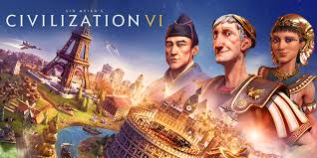


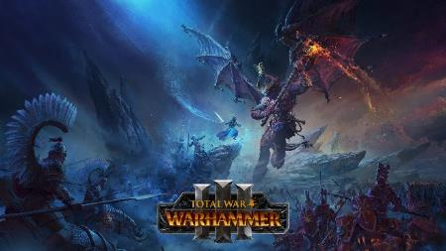
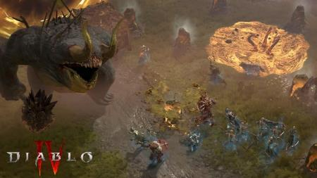
Game AI

Slide 2
Turn Base Games Achievement
Checkers: Chinook ended 40-year-reign of human world champion Marion Tinsley in 1994. Used a precomputed endgame database defining perfect play for all positions involving 8 or fewer pieces on the board, a total of 444 billion positions.
Chess: Deep Blue defeated human world champion Garry Kasparov in a six-game match in 1997. Deep Blue searches 200 million positions per second, uses very sophisticated evaluation, and undisclosed methods for extending some lines of search up to 40 ply.
Backgammon: TD-Gammon 1992, Reliably ranked in top-three players of world.
Othello: human champions refuse to compete against computers, who are too good.
Go: human champions refuse to compete against computers, who are too bad.

Slide 3
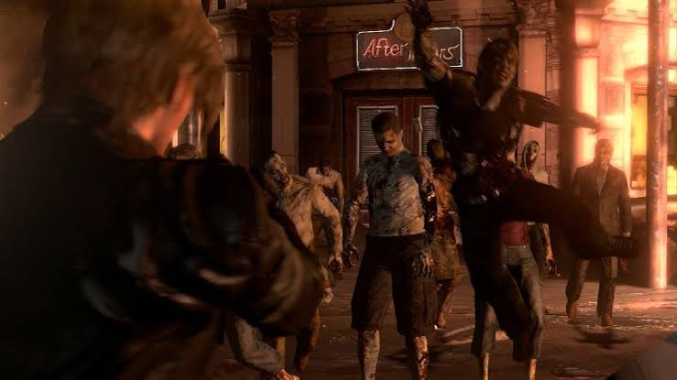
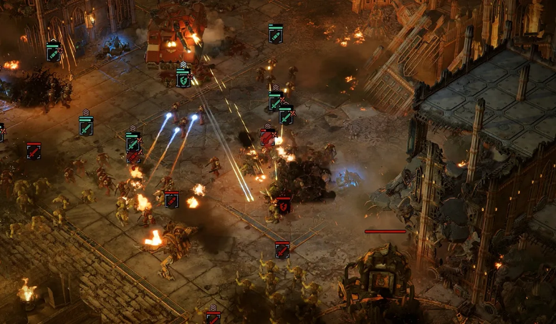
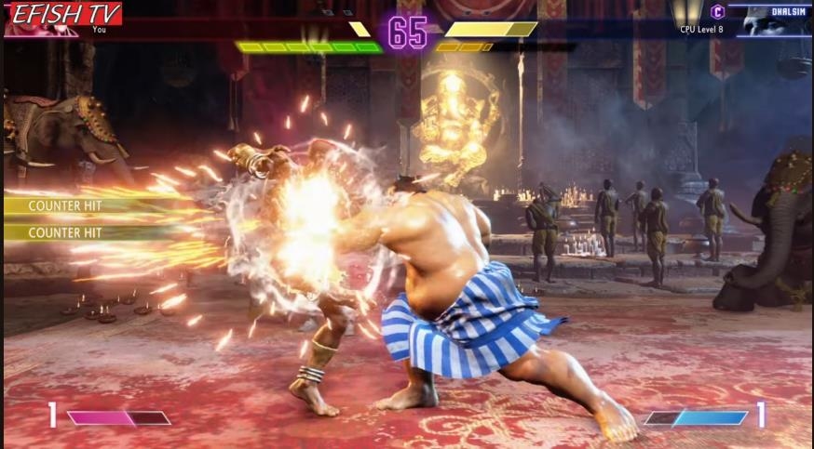
Real Time Games
Resident Evil 6
Warhammer 4K: Dawn of War IV
Street Fighter VI

Slide 4
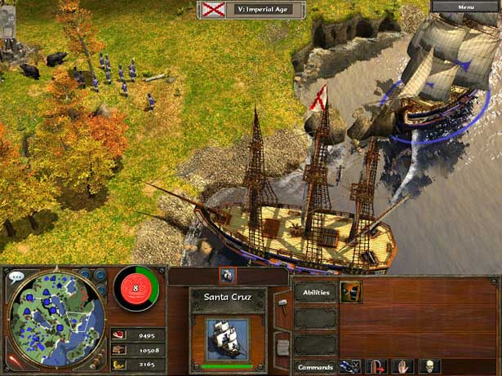
Real Time Abstract Controller
Can we use Minimax or its variants?
  Theoritically, Yes
    Multi Thread.
    CutOff Test & Eval Function
But, no real time games used it. Why?
  Real Time Games needs to use all of computer resources for everything (Graphics rendering, Sound, Action Oriented AI, etc) at the same time.

Slide 5
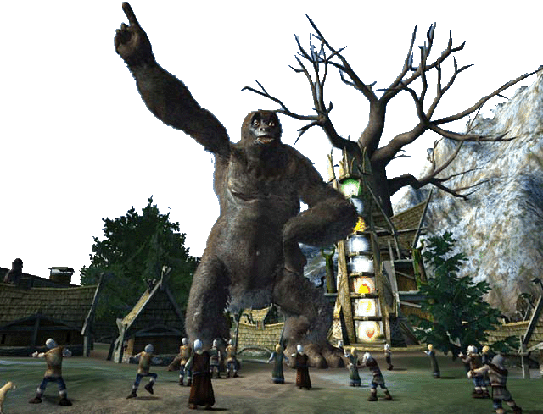
Real Time Abstract Controller
Rule Base System
Machine Learning
Evolutionary Strategy
Technique | Games | Applications
Decision Tree | Black & White | Prediction Classification Learning
Neural Network | Black & White BC3K Creature Heavy Gear Quake Battlecruiser | Memory Pattern recognition Learning Prediction Classification Behavioural control
Genetic Algorithm | Cloak & Dagger DNA Creatures Return Fire II | Optimisation Learning Developing game strategies Evolve behaviour Pathfinding

Slide 6
Rule-based AI
Generally refer to AI systems that consist of a set of if-then (or if-else) style rules
Technically, FSMs and DTs are types of rule-based systems. Rules are used to handle state transitions and decision nodes
But more specifically, “rule-based systems” are also commonly referred to its usage in expert systems

Slide 7
Rule-based Systems for Games
Rule-based systems are useful in GAMES…
  Because knowledge encoded in rules is modular
  Rules can be encoded in any order → flexible for coding and modifying the system at a later time
Let’s look at a game example that can use a rule-based system…

Slide 8
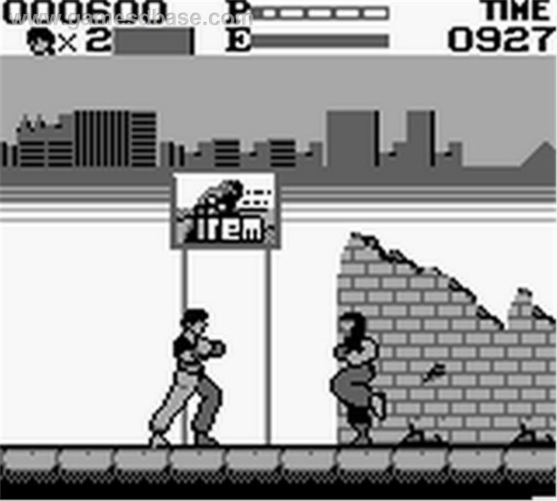
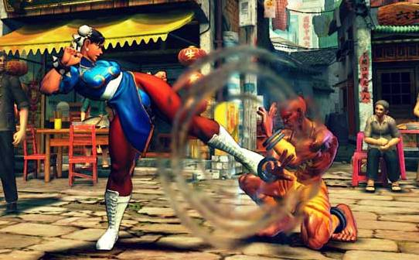
Example:
Fighting Game Strike Prediction
Kungfu Gameboy
Use 27 rules to capture all possible three-strike combinations of punch, low kick, and high kick.
Use the rules to predict next enemy strikes.
Rule based example
Read:
AI for Game Developers (2004)
By David M. Bourg & Glenn Seeman
Chapter 11.

Slide 9
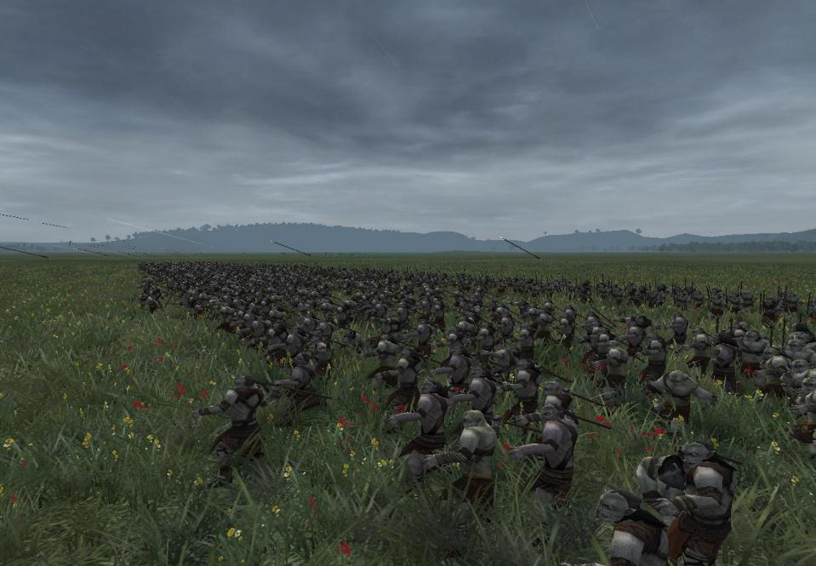
Rule-Based Systems
System consists of:
  A rule set - the rules to evaluate
  A working memory - stores state
  A matching scheme - decides which rules are applicable
  A conflict resolution scheme - if more than one rule is applicable, decides how to proceed
Rule:
  IF / THEN structure that logically relates information in the IF part to other information in THEN part.
  Eg: If distance < 75 And have Javelin Then throw Javelin
  If distance < 10 Then engage combat (using Gobang)
Notes:
<

Slide 10
Rule-Based Systems Structure
Program
Procedural Knowledge
Long-term Knowledge
Rule Memory
Match
Act
Conflict
Resolution
Data
Declarative Knowledge
Short-term Knowledge
Working Memory
Inference Engine
Notes:
If then rules
No program counter – no sequential code

Slide 11
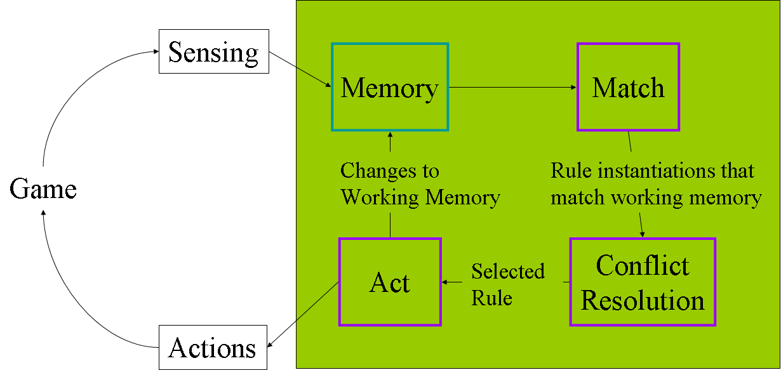
AI Cycle

Slide 12
Example: Medieval RTS game
Aim: Enable the computer opponent to keep track of player’s current state of technology
  By collection of knowledge of the player from the world state (resources, units, facilities)
  “Cheating” and having perfect knowledge will not give fair and realistic AI behaviors
How to assess state of technology?
  Sending scouts to collect information and observe (just like what human players do)
  Make inferences via a rule-based system

Slide 13
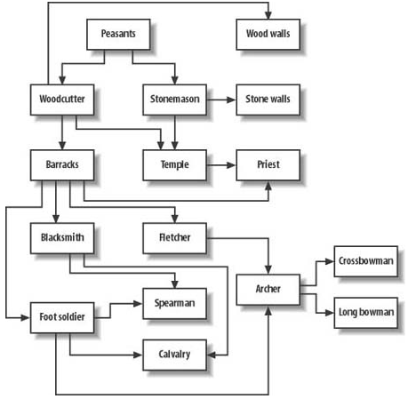
Example: Medieval RTS game
Technology Tree
  An important element in RTS games
  Shows the links between units to train, facilities to build and resources to harvest in order to expand influence in game

Slide 14
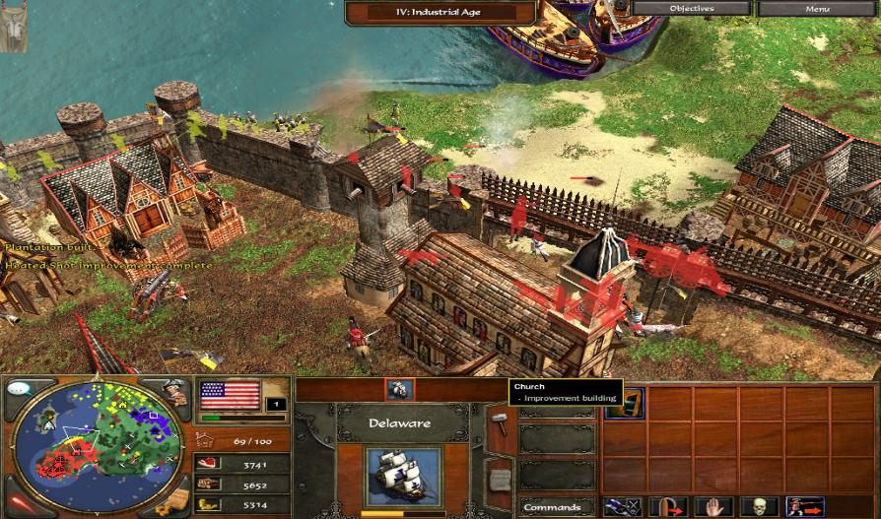
Example: Tracking Enemy (player) technology
Rules:
R1: if (Peasants == Yes && Woodcutter == Unknown)
Woodcutter = Maybe;
R2: if (Peasants == Yes && Stonemason == Unknown)
Stonemason = Maybe;
R3: if (Woodcutter == Yes && Barracks == Unknown)
Barracks = Maybe;
R4: if (Woodcutter == Yes && Stonemason == Yes && Temple == Unknown) Temple = Maybe;
R5: if (Barracks == Yes && Blacksmith == Unknown)
Blacksmith = Maybe;
R6: if (Fletcher == Yes && FootSoldier == Yes &&
Archer == Unknown) Archer = Maybe;
R7: if (Woodcutter == Yes && WoodWalls == Unknown)
WoodWalls = Maybe;
R8: if (Stonemason == Yes && StoneWalls == Unknown)
StoneWalls = Maybe;
R9: if (Archer == Yes && Crossbowman == Unknown)
Crossbowman = Maybe;
R10: if (Archer == Yes && Crossbowman == Unknown) Crossbowman = Maybe;
R11: if (Archer == Maybe && Longbowman == Unknown) Longbowman = Maybe;
R12: if (Longbowman == Yes) {
Archer = Yes;
Fletcher = Yes;
FootSoldier = Yes;
Barracks = Yes;
Woodcutter = Yes;
}
R13: if (Cavalry == Yes){
Blacksmith = Yes;
FootSoldier = Yes;
Barracks = Yes;
Woodcutter = Yes;
}
R14: if (StoneWalls == Yes) Stonemason = Yes;

Slide 15
Example: Tracking Enemy (player) technology
Working Memory: Default value = unknown
Assume:
Fact from the scout:
Peasant = yes
Inference Engine???
enum TMemoryValue{Yes, No, Maybe, Unknown};
TMemoryValue Peasants;
TMemoryValue Woodcutter;
TMemoryValue Stonemason;
TMemoryValue Blacksmith;
TMemoryValue Barracks;
TMemoryValue Fletcher;
TMemoryValue WoodWalls;
TMemoryValue StoneWalls;
TMemoryValue Cavalry;
TMemoryValue FootSoldier;
TMemoryValue Spearman;
TMemoryValue Archer;
TMemoryValue Temple;
TMemoryValue Priest;
TMemoryValue Crossbowman;
TMemoryValue Longbowman;

Slide 16
Inference in Rule-based Systems
Forward Chaining
  Match rules (if-parts) to facts in working memory
  If a rule matches, it is fired and its then-part is executed
  Potentially, if more than one rule matches the given set of facts, a conflict resolution phase is required to figure out which rule to fire
  Conflict resolution: Many possible ways – (1) first matched rule, (2) random rule, (3) largest weighted rule

Slide 17
Inference in Rule-based Systems
Forward Chaining
  Example
    If working memory indicates Peasants = Yes and Woodcutter = Unknown, the rule:
      if(Peasants == Yes && Woodcutter == Unknown) Woodcutter = Maybe;
      , matches. So, this rule can potentially be fired
      (depending on which other rules are also matched)

Slide 18
Rule-based System Basics
The AI can gather facts by sending out scouts to see more about the player.
  In another way, we can use a set of if-then style rules to infer the technology that the player has (before a scout confirms it)
Example, next, scout found Woodcutter and Stonemason:
  if(Woodcutter == Yes && Stonemason == Yes && Temple == Unknown)
    Temple = Maybe

Slide 19
Rule-based System Basics
Inference can work the other way as well
  If the player has been observed to have a priest, it can be inferred that the player also must have a temple, therefore, must have a barracks, a woodcutter, and a stonemason
Example “priest” rule:
  if(Priest == Yes) {
  Temple = Yes;
  Barracks = Yes;
  Woodcutter= Yes;
  Stonemason= Yes;
  }

Slide 20
Rule-based System Basics
In reality, developers not build rule-based systems using actual hard-coded if-statements
  Some types of inferences are hard to achieve
  Very inflexible as the rules need to be handcrafted one by one to strike a good balance among them
  Definitely not efficient for future modifications!
Developers often use scripting languages (LUA) or shells to create and modify rules without having to change the source code and recompile.

Slide 21
Optimization of RBS
For small rule sets,
  Forward chaining is fast
For large-scale rule-based systems, optimisation is essential
  Many rules may be matched for firing, so the conflict resolution phase must be optimized ➔ Rete Algorithm
Write your own scripting language (instead of 3rd party ones) to reduce implementation overhead

Slide 22
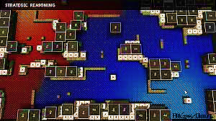
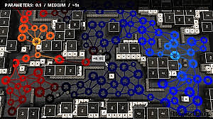
Influence Maps¹
Strategic assessment / decision-making
Usually strategy games
Spatial representation of AI’s knowledge about the game world
Strategic perspective of game state layered over geographical
¹Tozour, P. (2001) Influence Mapping. In M. Deloura (Ed.), Game Programming Gems 2. Hingham, MA: Charles River Media, Inc., pp. 287-297.

Slide 23
Influence Maps
Influence map indicates:
  where the AI’s forces are deployed
  where the enemy is / most likely to be
  where the “frontier” between players lies
  what areas are yet to be explored
  where significant battles have occurred
  where enemies are most likely to attack in the future
IM’s structure makes it possible to make intelligent inferences about:
  areas of high strategic control
  weak spots in an opponent’s defences
  prime “camping” locations
  strategically vulnerable areas
  other meaningful features that human players would choose through intuition.

Slide 24
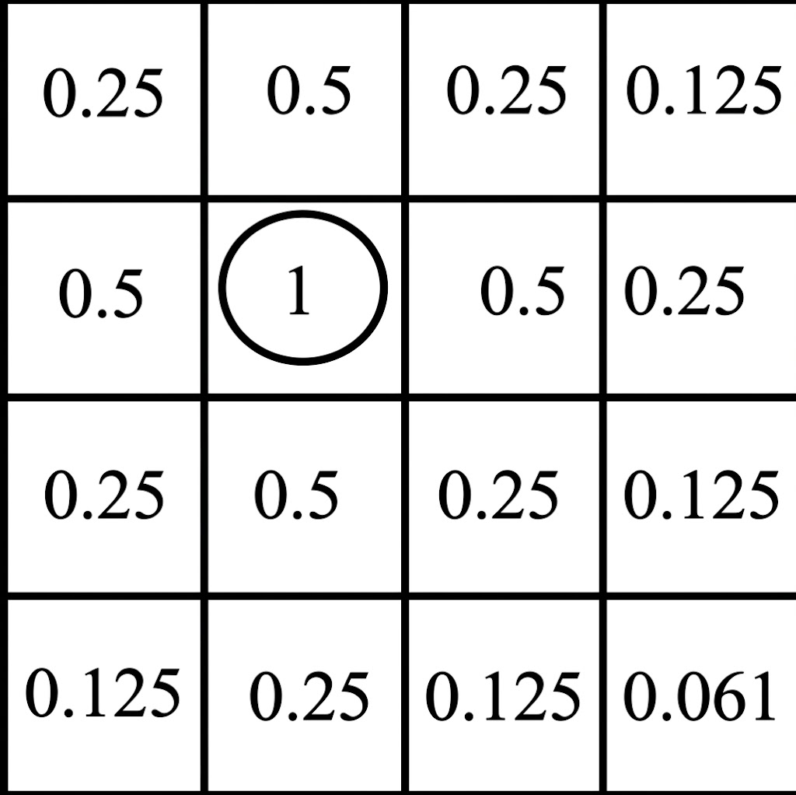
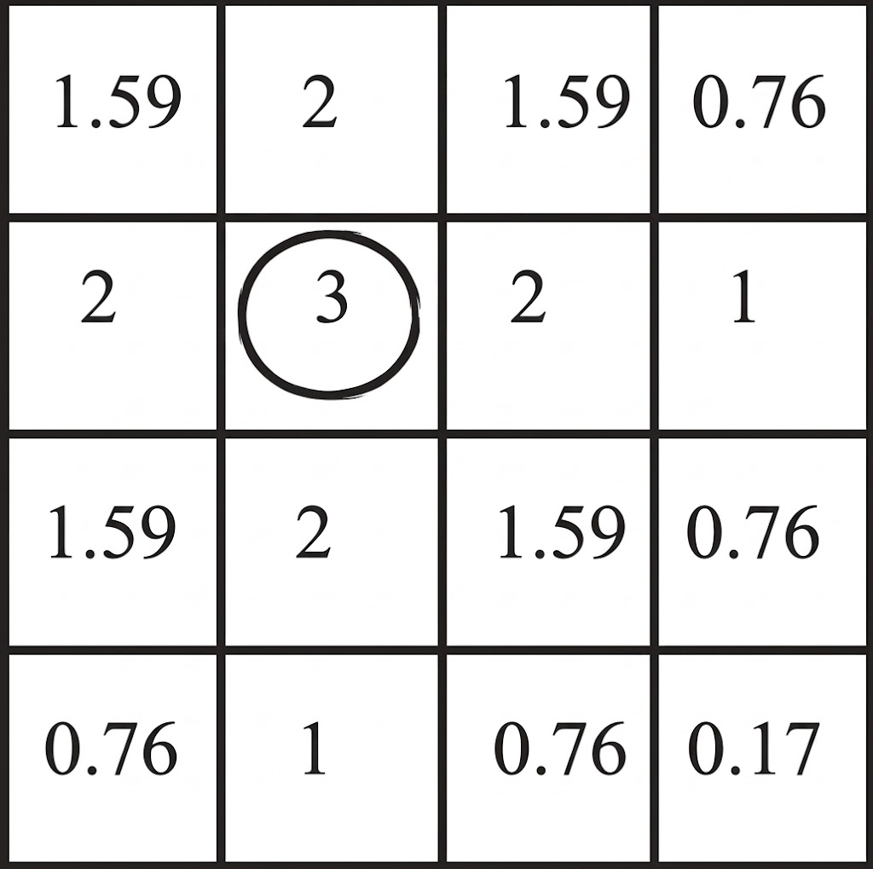
Influence Maps
IM tracks variables separately for each player (multiple parallel IM’s)
Each AI keeps one IM for itself and one for every other player
Could keep one IM and let all AI’s access it (but this is cheating)

Slide 25
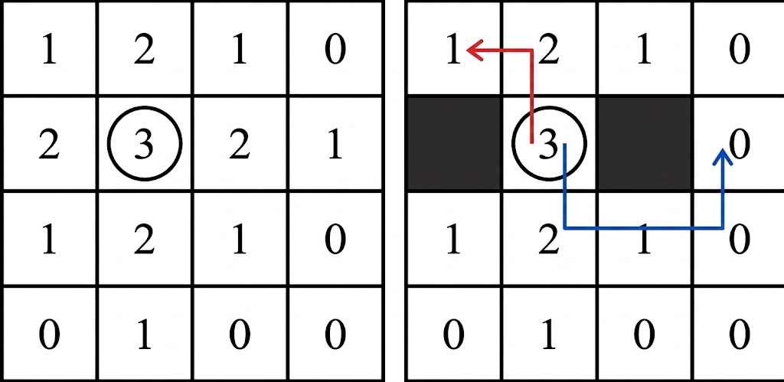
Influence Propagation
Once initial values given to cells, needs to be propagated
More accurate strategic perspective – current influence / potential influence
Spread influence with “falloff” rule
Selection of falloff rules is subjective, requires tweaking and tuning
Exponential falloff – choose a constant 0..1
Need to terminate falloff (never reaches 0)
Falloff should be proportional to cell size

Slide 26
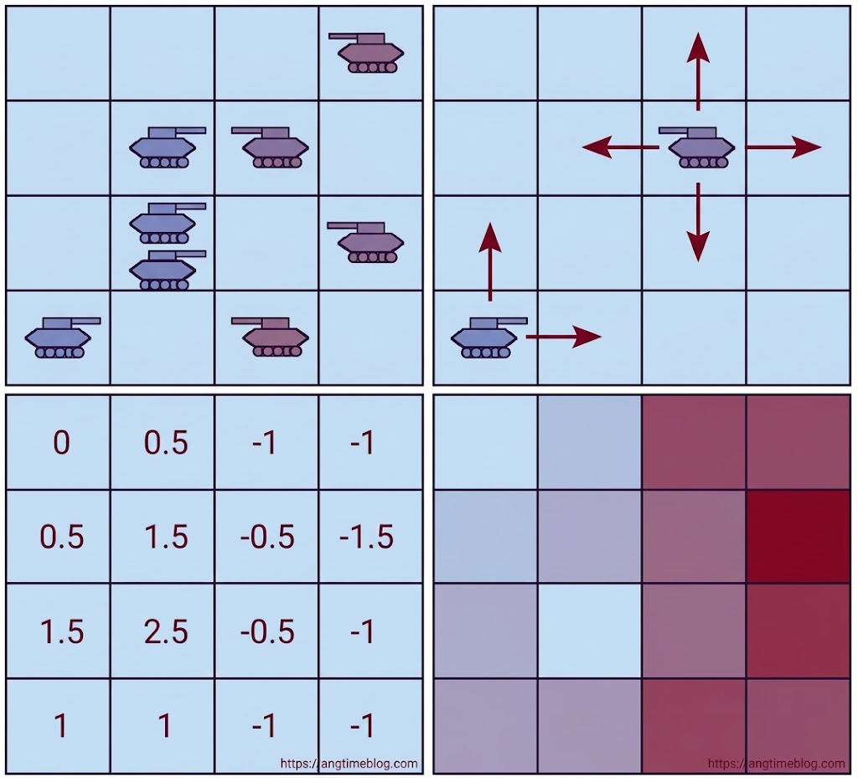
Influence Propagation
Top-left:
  Game state
Top-right:
  Propagation
Lower-left:
  Influence values
Lower-right:
  Influence grey scale
²Sweetser, P. (2004) Strategic Decision-Making with Neural Networks and Influence Maps. In S. Rabin (Ed.), AI Game Programming Wisdom 2. Hingham, MA: Charles River Media, Inc., pp. 439-446.

Slide 27
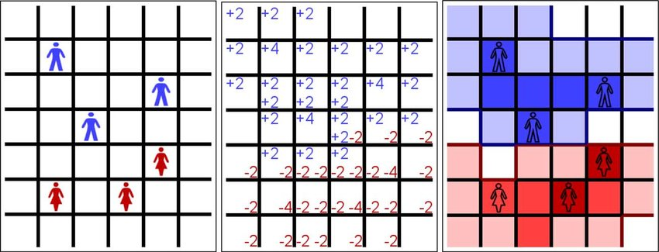
Influence Propagation
Preuss, Mike & Hochstrate, Nicola & Danielsiek, Holger & Hein, Tobias & Naujoks, Boris & Piatkowski, Nico & Stüer, Raphael & Thom, Andreas & Wessing, Simon. (2010). Towards Intelligent Team Composition and Maneuvering in Real-Time Strategy Games. Computational Intelligence and AI in Games, IEEE Transactions on. 2. 82 - 98. 10.1109/TCIAIG.2010.2047645.

Slide 28
Weighted Sums for Desirability
Weighted sums are simple / transparent
But:
  Choosing the relevant variables is difficult
  Finding good weights is time-consuming
  Important info might be lost

Slide 29
Alternative to Weighted Sums
Simulated annealing or evolutionary approaches (GA, PSO) to find weights
Neural networks (MLP):
  Determine variables that most influence the decision / ignore irrelevant variables
  Variables are analysed in parallel; info in individual variables is not lost
  Weights are determined during training
Sweetser, P. (2004) Strategic Decision-Making with Neural Networks and Influence Maps. In S. Rabin (Ed.), AI Game Programming Wisdom 2. Hingham, MA: Charles River Media, Inc., pp. 439-446.

Slide 30

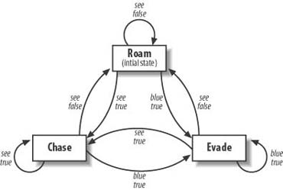
Finite State Machines (Otomata)
A Finite State Machine depicts the entity's (virtual character’s) brain as:
  A group of possible actions (the states)
  Ways to change from one action to the other.
The Ghosts in Pac Man:
  Roam freely
  Chase the player
  Evade the player (if blue)

Slide 31
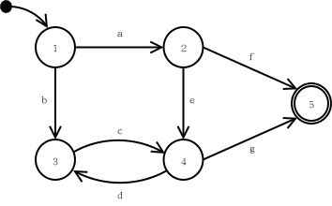
FSM’s in Theory
Simple theoretical construct
  Set of states (S)
  Input vocabulary (I)
  Transitional function T(s,i)
A way of denoting how an object can change its state over time.

Slide 32
FSM’s in Practice
Each state represents some desired behavior.
The transition function T resides across all states.
  Each state “knows” how to transition to other states.
Accepting states (those that require more input) are considered to be the end of execution for an FSM.
Input to the FSM continues as long as the game continues.

Slide 33
FSM’s in Games
Character AI can be modeled as a sequence of mental states.
World events can force a change in state.
The mental model is easy to grasp, even for non-programmers.
Monster In Sight
Gather
Treasure
Flee
No Monster
Fight
Monster Dead
Cornered

Slide 34
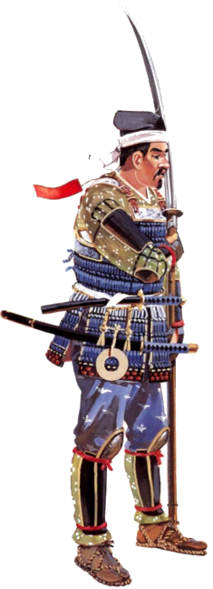
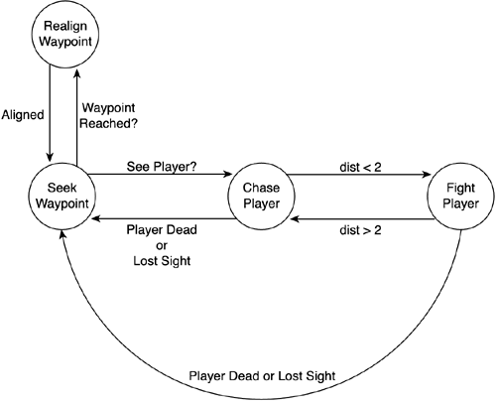
Finite State Machines
The enemy is in an outdoors area with no obstacles.
He carries a long sword.
He has a predefined set of waypoints to patrols in a cyclical way.
The enemy activates when you get inside his viewing cone.
If he sees you, he chases you around.
If in close contact, he will remain stopped and hitting you with the sword.
The Patrolling Enemy

Slide 35
Finite State Machines
#define SEEK_WAYPOINT 0
#define REALIGN_WAYPOINT 1
(...)
int state;
switch (state)
{
case 0:
{
// code for this specific state
break;
}
(...)
case N-1:
{
// code for this specific state
break;
}
}
The Patrolling Enemy

Slide 36
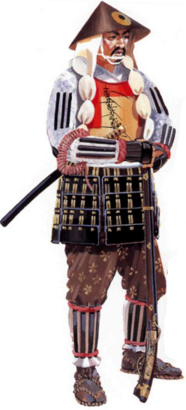
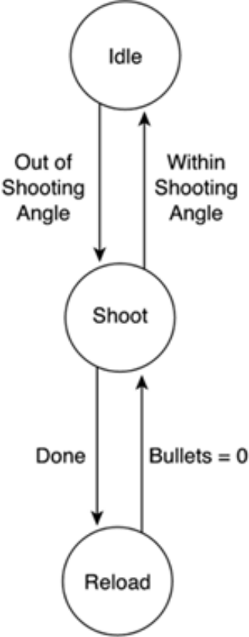
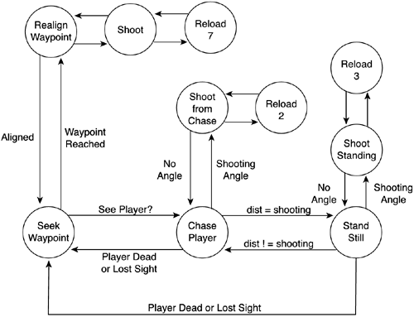
Finite State Machines
Enemy with a rifle

Slide 37
An Example of FSM
seeEnemy
wander
Attack
Win
Dead
Rot

Slide 38
Coding an FSM – Code Example 1
void RunLogic(int &state)
{
switch(state)
{
case 0: // Wander
Wander();
if (SeeEnemy()) state = 1;
if (Dead()) state = 2;
break;
case 1: // Attack
Attack();
if (Win()) state = 0;
if (Dead()) state = 2;
break;
case 2: // Dead
SlowlyRot();
break;
}
}

Slide 39
Coding an FSM – Code Example 2
void RunLogic(FSM *fsm)
{
// Do action based on the state and determine next input
input = STATE_NULL;
switch(fsm->GetStateID())
{
case STATE_WANDER: // Wander
Wander();
if (SeeEnemy()) input = STATE_SEE_ENEMY;
if (Dead()) input = STATE_DEAD;
break;
case STATE_ATTACK: // attack
Attack();
if (Win()) input = STATE_WANDER;
if (Dead()) input = STATE_DEAD;
break;
case STATE_DEAD: // Dead
SlowlyRot();
break;
}
// DO state transition based on computed input
fsm->StateTransition(input);
}

Slide 40
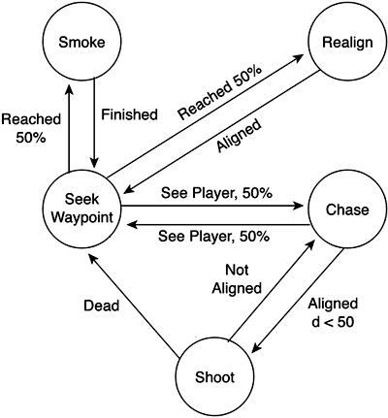
Nondeterministic FSM
The Enemy has a certain degree of "virtual freedom,"
Can choose different action courses randomly.
Make his AI less predictable and more engaging.
Nondeterminism is especially important for those AI entities that appear in groups.
  reduce the homogeneous, boring look of the different entity performing the same task.

Slide 41
Hierarchical FSM
Attack
D
Wander
~E
Pickup
Power Up
E
~S
Chase
SN
E
SP
S
S
SP
Start
Turn
Right
DF
SN
D
Spawn
SN
SP
~E
DF
DF
Go-
through
Door
Note:
SN: see nothing
SP: see power up
DF: door in the front
Note:
E: see an enemy
S: hear a sound
D: die

Slide 42
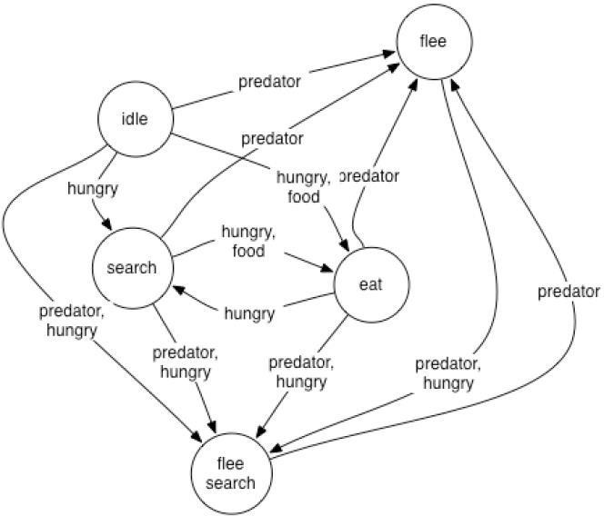
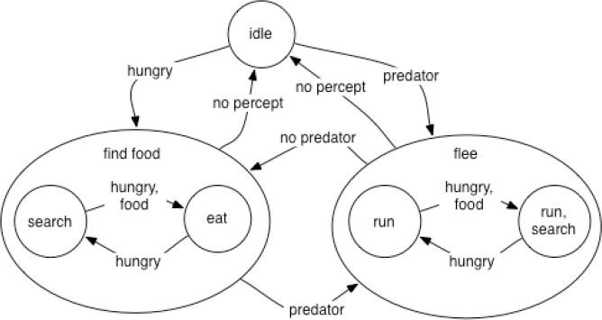
Hierarchical FSM Example
Equivalent to regular FSMs, adding recursive multi-level evaluation
Easier to think about encapsulation
Hierarchical approach addresses entry, update, exit and any (wildcard) at multiple levels
But how to deal with the transition from a lower-level state?

Slide 43
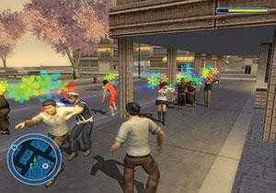
Hierarchical FSMs in
Destroy All Humans 2
http://www.gamasutra.com/view/feature/130279/creating_all_humans_a_datadriven_.php

Slide 44
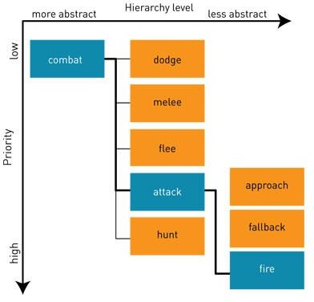
Hierarchical FSMs in
Destroy All Humans 2
Active (blue), pending (orange)
Only active behaviors update
Only active behaviors have children
If * children startable, rank
States can be marked as non-interruptable or non-blocking

Slide 45
Non-Deterministic Hierarchical FSM
Attack
Adds variety to actions
Have multiple transitions for the same event
Label each with a probability that it will be taken
Randomly choose a transition at run-time
Approach
.3
Aim &
Slide Right
& Shoot
.3
Start
.3
.4
.3
Aim &
Slide Left
& Shoot
.4
Aim &
Jump &
Shoot
Notes:
If two arcs are two, pick according to probability

Slide 46
FSM Example
Attack-ES
E,-D,S,-L
Attack-E
E,-D,-S,-L
S
Retreat-S
-E,-D,S,L
Worst case:
Each extra state variable can add 2^{n} extra states
  n = number of existing states
-S
L
L
-L
E
-E
E
Wander-L
-E,-D,-S,L
E
-L
Retreat-ES
E,-D,S,L
-L
E
L
-S
Using a stack would allow much of this behaviour without the extra states (Pushdown Automata (PDA)).
-L
L
Retreat-E
E,-D,-S,L
Wander
-E,-D,-S,-L
-E
-E
E
D
D
Chase
-E,-D,S,-L
D
D
Spawn
D
(-E,-S,-L)
S

Slide 47
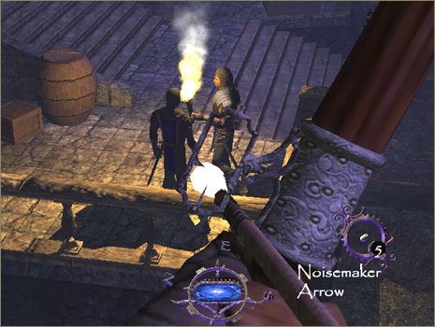
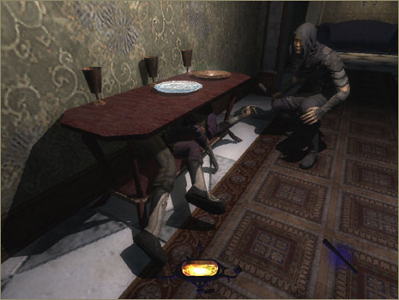
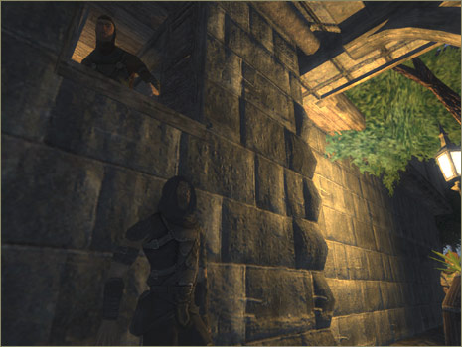
Stack FSM – Thief 3
Stack allows AI to move back and forth between states.
Leads to more realistic behavior without increasing FSM complexity.

Slide 48
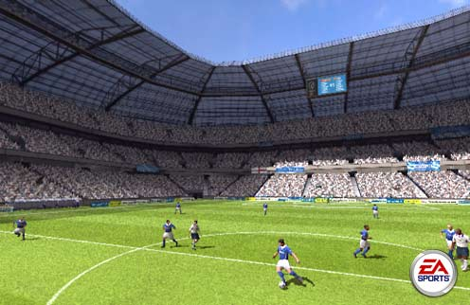
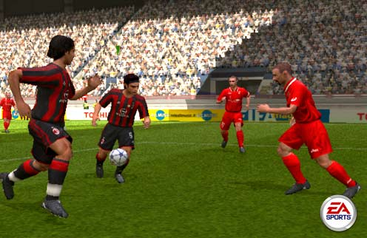
More FSM Extensions
Fuzzy State Machines
  Degrees of truth allow multiple FSM’s to contribute to character actions.
Multiple FSM’s
  High level FSM coordinates several smaller FSM’s.
Polymorphic FSM’s
  Allows common behavior to be shared.
  Soldier -> German -> Machine Gunner

Slide 49
Polymorphic FSM Example
Soldier
Rifleman
Machine Gunner
Officer
American
German
American
German
American
German
British
Soviet
British
Soviet
British
Soviet

Slide 50
Disscusion & Project Gasal 26/27 :
Design a Virtual Character AI
Virtual Character:
Kelompok 1: Jedi (Ahsoka Tano/Mace Windu)
Kelompok 2: Sith (Darth Vader/Darth Maul)
Kelompok 3: Mandalorian & Grogu (1.5 orang)
Kelompok 4: Chirrut Îmwe & Baze Malbus
Kelompok 5: Boba Fett & Fennec Shand

